Slide 1
CREATING A WEBSITE ON BLOOD BANK MANAGEMENT SYSTEM
J.Poojitha (192211829)
P.Aasreetha (192211746)

Slide 2
PROBLEM STATEMENT:
In many regions, blood banks face significant challenges in efficiently managing their operations, including donor registration, blood collection, inventory management, and distribution to hospitals. The lack of a cohesive and user-friendly system can lead to inefficiencies, such as delays in blood availability, difficulties in tracking blood inventory, and challenges in coordinating with donors and hospitals.
To address these issues, there is a need for a comprehensive Blood Bank Management System (BBMS) that integrates various functions into a single, accessible online platform. This system should streamline the processes of donor management, blood collection, inventory tracking, and blood distribution. It should also facilitate communication between blood banks, donors, and healthcare facilities.

Slide 3
ABSTRACT:
The Blood Bank Management System (BBMS) is a web-based platform designed to enhance the efficiency and effectiveness of blood bank operations. This system addresses the critical challenges faced by blood banks, including donor management, blood collection, inventory control, and blood distribution. By integrating these functions into a single, user-friendly interface, the BBMS aims to streamline processes, improve communication, and optimize resource allocation.Additionally, the BBMS offers robust reporting and analytics tools, enabling users to generate insights into donation patterns, inventory usage, and distribution efficiency. These insights support data-driven decision-making and continuous improvement of blood bank operations.With an emphasis on user experience, the BBMS features an intuitive and responsive design, accessible across various devices.

Slide 4
EXISTING SYSTEM:
The current systems used by many blood banks for managing their operations are often fragmented and may rely on outdated technology or manual processes. Here’s a general overview of the existing systems and their limitations:
Manual Record-Keeping
Basic Digital Systems
Limited Integration
Inefficient Donor Management
Inadequate Inventory Management
Manual Distribution Coordination
Limited Reporting and Analytics
User Experience Issues

Slide 5
PROPOSED SYSTEM:
The proposed Blood Bank Management System (BBMS) is a comprehensive web-based platform designed to address the limitations of existing systems by integrating and automating blood bank operations. This system will enhance efficiency, improve communication, and provide real-time insights through a user-friendly interface. It aims to streamline donor management, blood collection, inventory control, and distribution processes, ultimately improving the effectiveness of blood bank operations and patient care.The proposed Blood Bank Management System aims to modernize blood bank operations, improve efficiency, and ultimately enhance patient care by ensuring the timely availability of blood products and effective coordination between all stakeholders.

Slide 6
MODULE DESCRIPTION
To develop the Blood Bank Management System (BBMS), the project is divided into distinct modules, each handling specific functionalities. This modular approach ensures ease of maintenance, scalability, and a seamless user experience.
User Management Module:
Donor Management Module
Blood Inventory Management:
Request and Distribution Management:
Reporting and Analytics:
Notifications and Alerts:
Integration with External Systems:

Slide 7
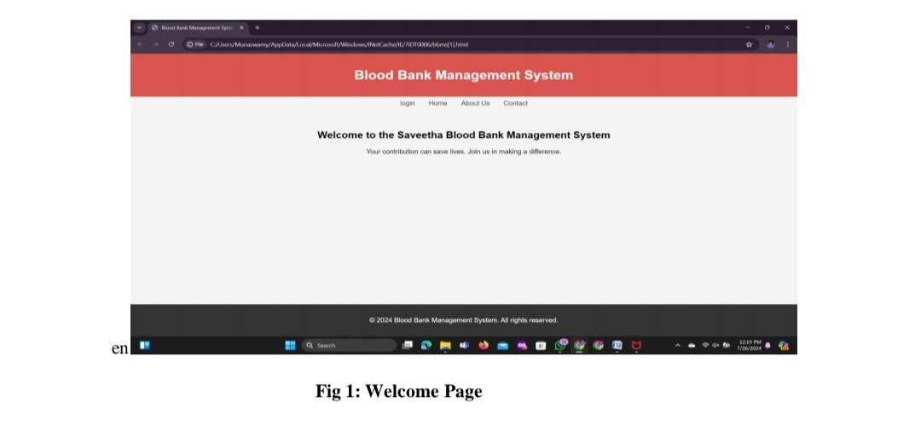
OUTPUT

Slide 8
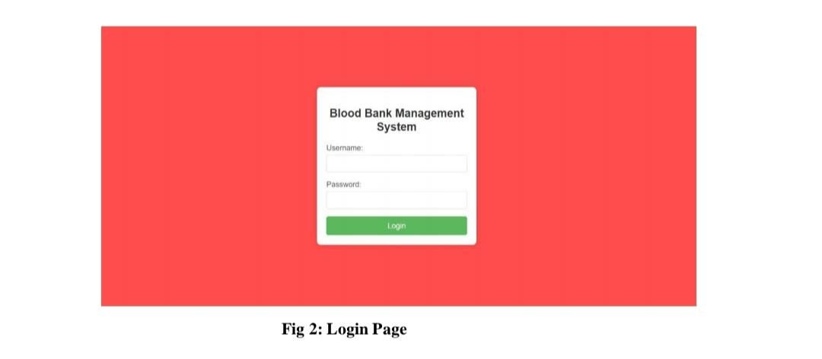

Slide 9
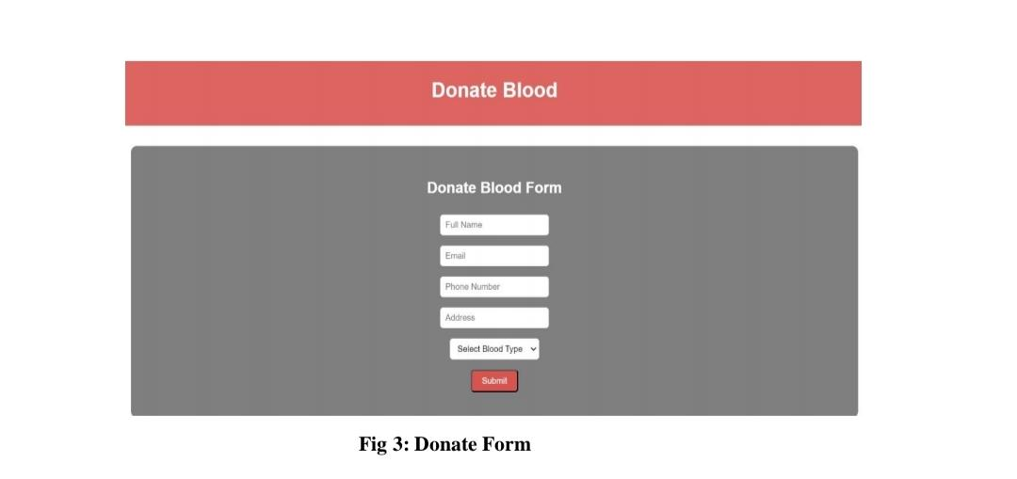

Slide 10
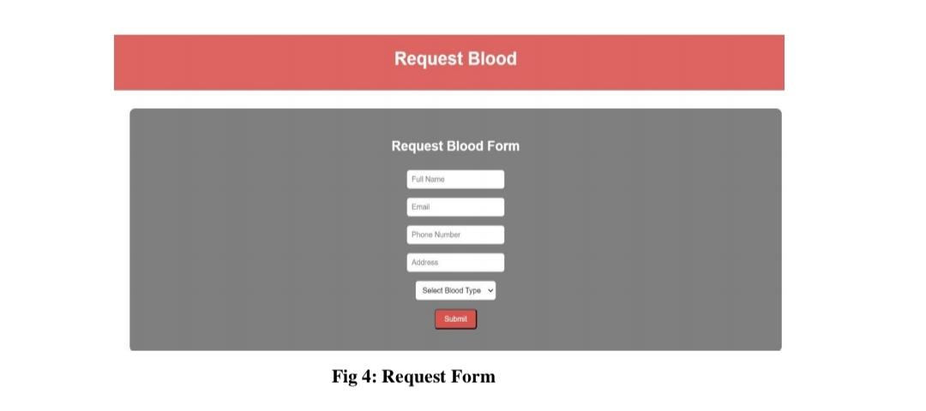

Slide 11
CONCLUSION
The BBMS not only addresses the current challenges faced by blood banks but also positions them to handle future demands more effectively. As the healthcare landscape evolves and blood bank needs grow, the system’s scalability and integration capabilities will support ongoing improvements and adaptability.
In conclusion, the Blood Bank Management System represents a transformative solution for modernizing blood bank operations. By leveraging technology to enhance efficiency, accuracy, and user engagement, the BBMS helps ensure that blood banks can meet the critical needs of healthcare providers and patients, ultimately saving lives and improving overall health outcomes. The successful implementation of this system will contribute to a more effective and responsive blood donation ecosystem, benefiting both donors and recipients alike.

Slide 12
FUTURE ENTERTAINMENTS
As technology continues to advance and the needs of blood banks evolve, the Blood Bank Management System (BBMS) can be further enhanced to incorporate cutting-edge features and capabilities. Here are several potential future enhancements to consider:
Artificial Intelligence and Machine Learning
Advanced Data Integration
Enhanced User Experience
Advanced Reporting and Visualization
Improved Donor Experience
Community and Social Engagement
Enhanced Security and Privacy

Slide 13
REFERENCE
1. http://www​.who.int/bloodsafety​/transfusion_services​/bts_learningmaterials​/en/index.html.
2. http://www​.who.int/bloodsafety​/voluntary_donation​/blood_donor​_selection_counselling/en/ [PubMed]
3. . http://www​.who.int/bloodsafety​/publications​/who_bct_02_03/en/index.html.
4. http://www​.who.int/worldblooddonorday​/Melbourne​_Declaration_VNRBD_2009.pdf.
5. http://www​.who.int/bloodsafety​/voluntary_donation​/blood_donor​_selection_counselling/en/ [PubMed]

